Slide 1

Version control with Github Desktop
Shuai Wei
IS&T Boston University

Slide 2
Setting up GitHub Desktop
Installing GitHub Desktop
https://desktop.github.com/
Authenticating to GitHub
Add your GitHub.com account information to GitHub Desktop
Configuring Git for GitHub Desktop
If you don’t have Git installed, you must configure it before using GitHub Desktop.

Slide 3
Git: main features
Track all your changes
Work along with others
Share work with others
With Git

Slide 4
Git Workflow
Local computer
Github.com

Slide 5
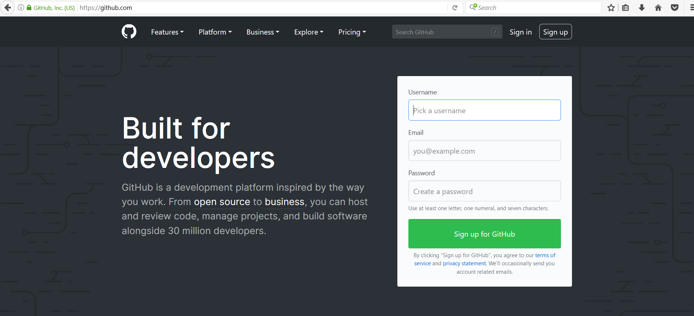
Github.com
A web-server that allows you to save/access your repository remotely.
Easy to share with collaborators.

Slide 6
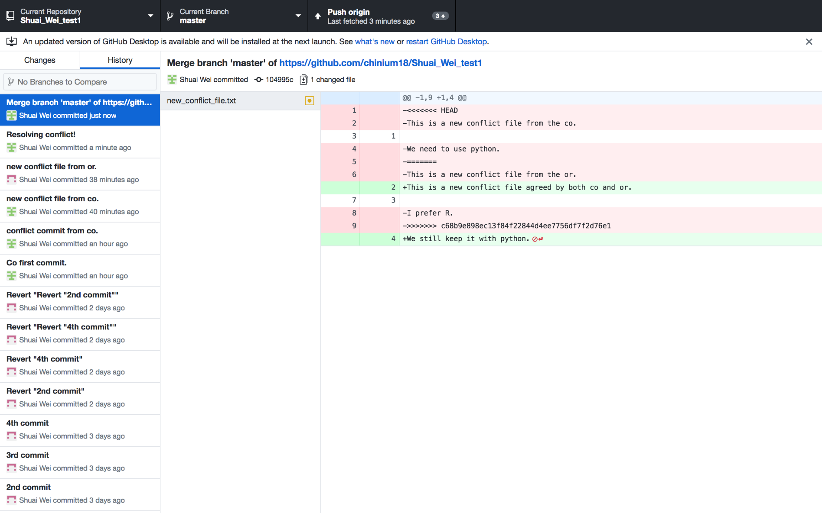
GitHub desktop
It’s a fast, easy way to contribute to projects from OS X and Windows.
GitHub workflow and replace GitHub for Mac and Windows with a unified experience across both platforms.

Slide 7
Setting up GitHub Desktop
Installing GitHub Desktop
https://desktop.github.com/
Authenticating to GitHub
Add your GitHub.com account information to GitHub Desktop
Configuring Git for GitHub Desktop
If you don’t have Git installed, you must configure it before using GitHub Desktop.

Slide 8
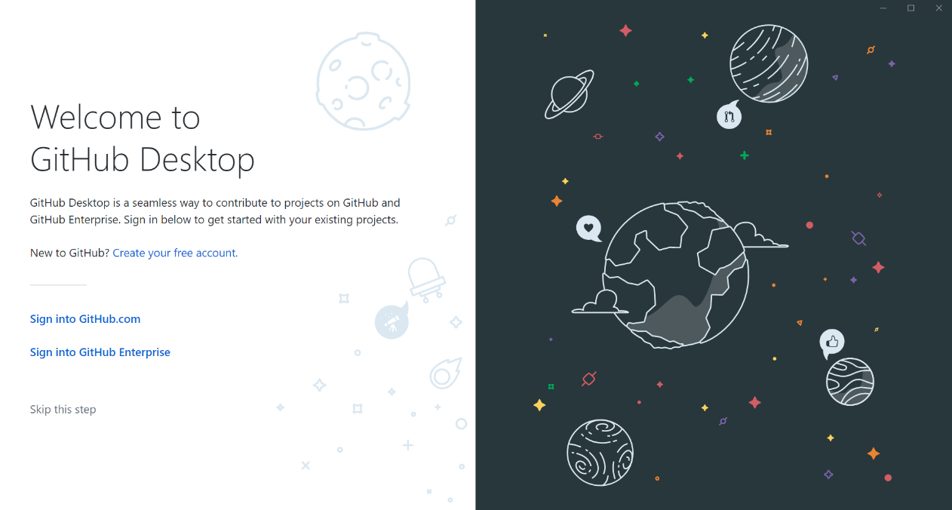
Authenticating to GitHub
or

Slide 9
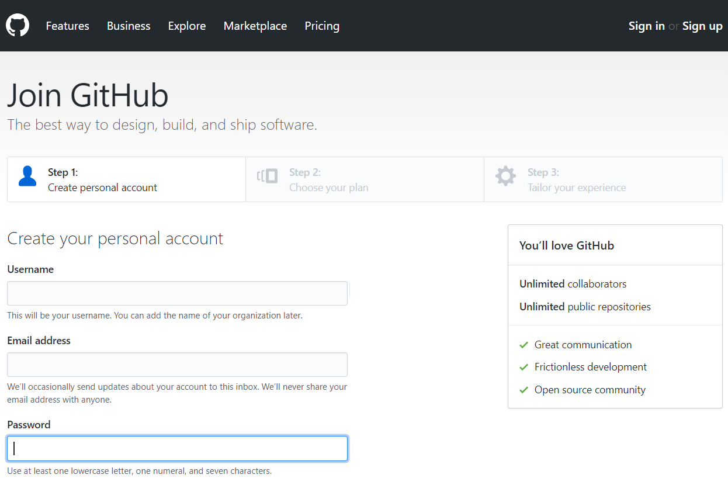
Creating GitHub account if you don’t have an account already

Slide 10
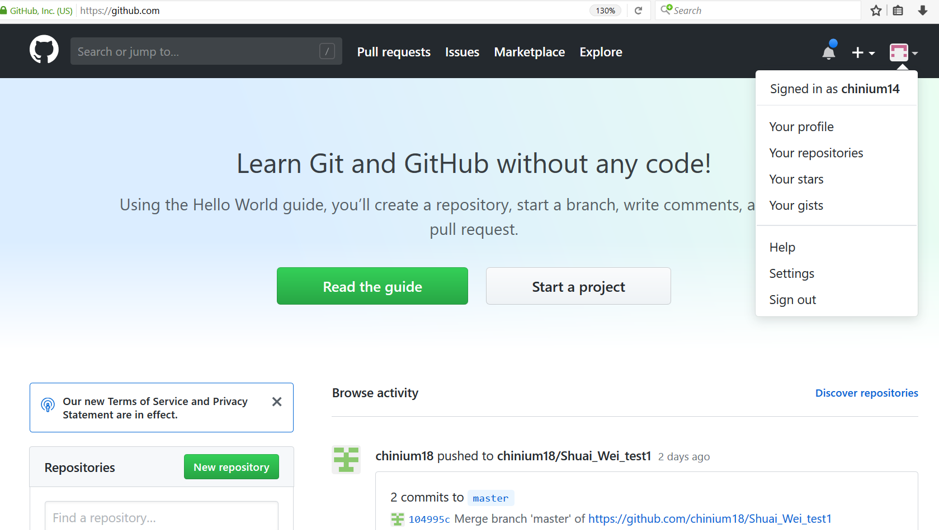
Configuring GitHub account

Slide 11
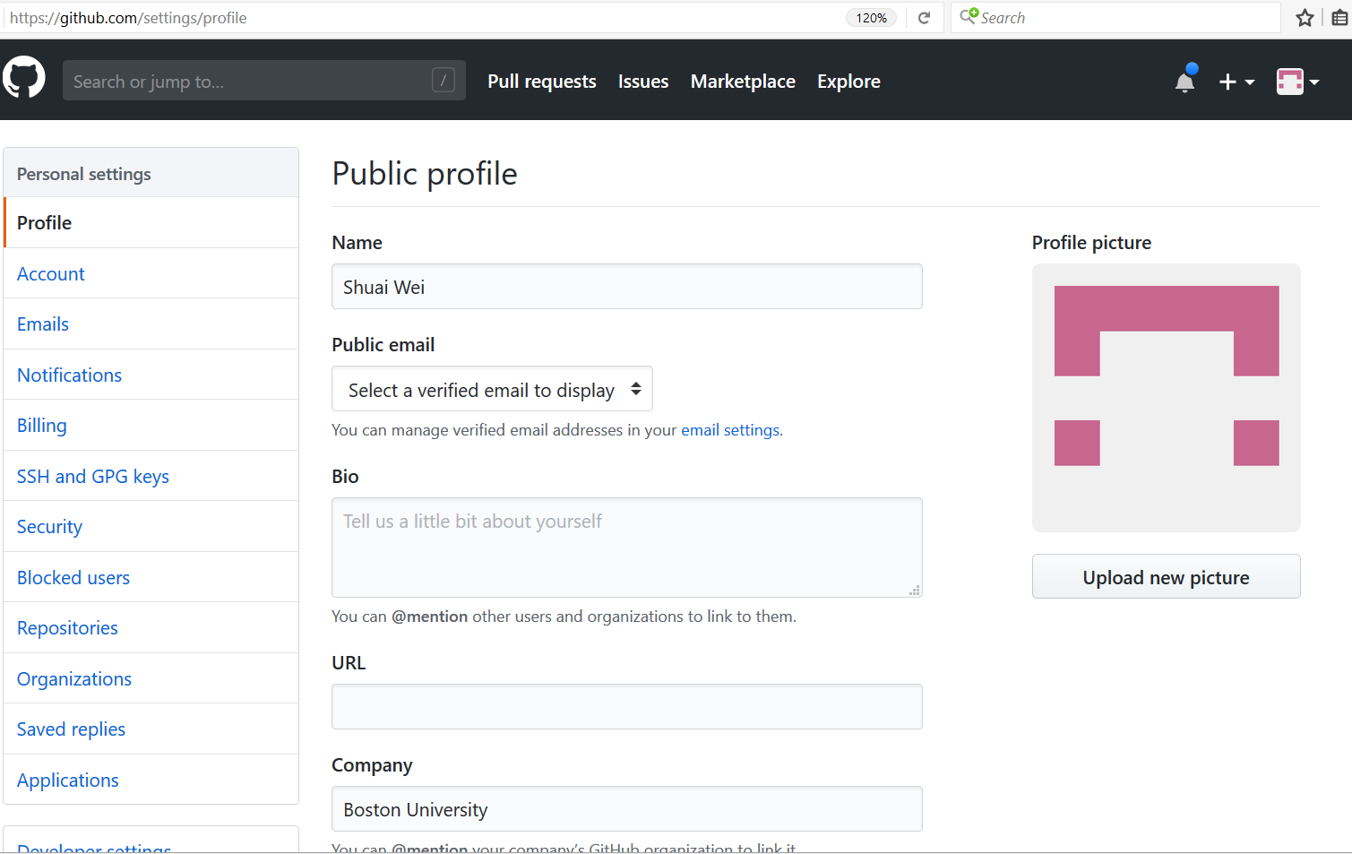
Configuring GitHub account

Slide 12
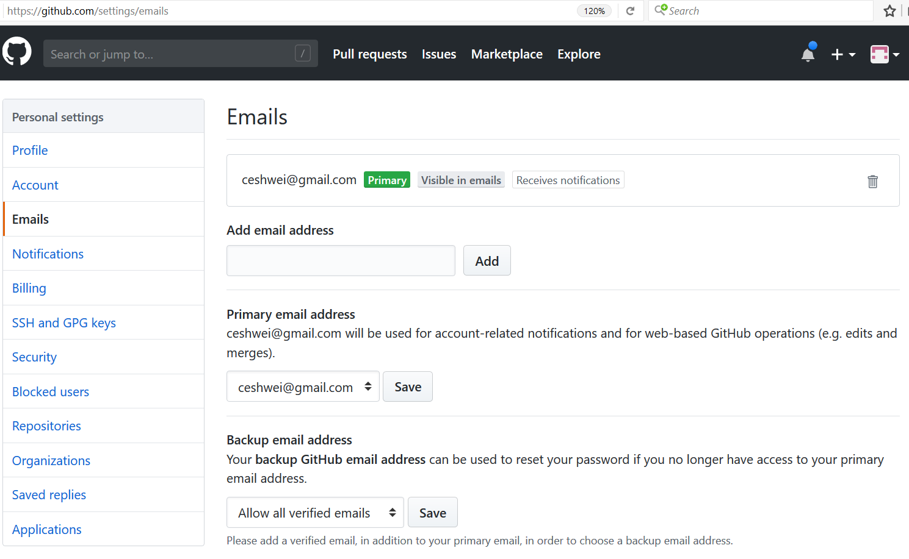
Configuring GitHub account

Slide 13
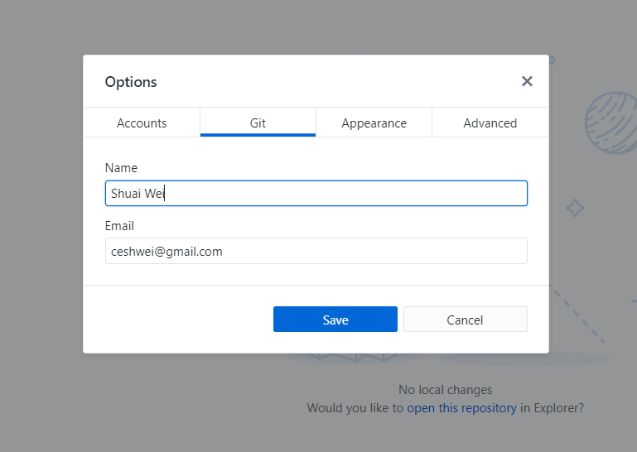
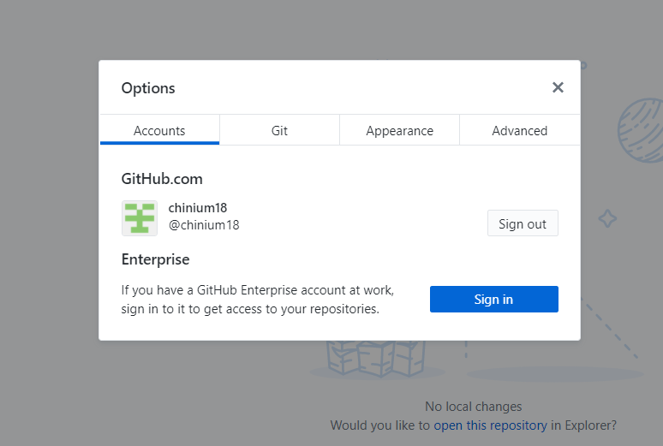
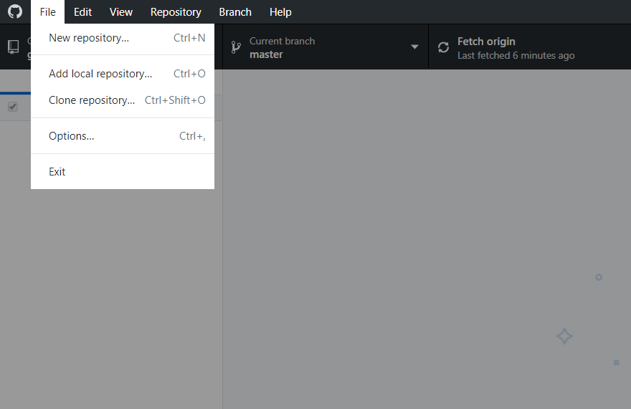
GitHub Desktop Setup

Slide 14
Using Github desktop for version control
Track and visualize each update of your code.
Revert a previous version/commit.
Branch out for large project development.

Slide 15
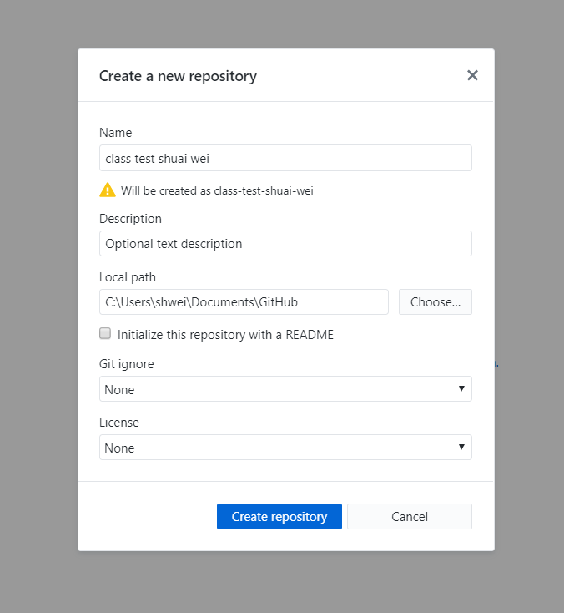
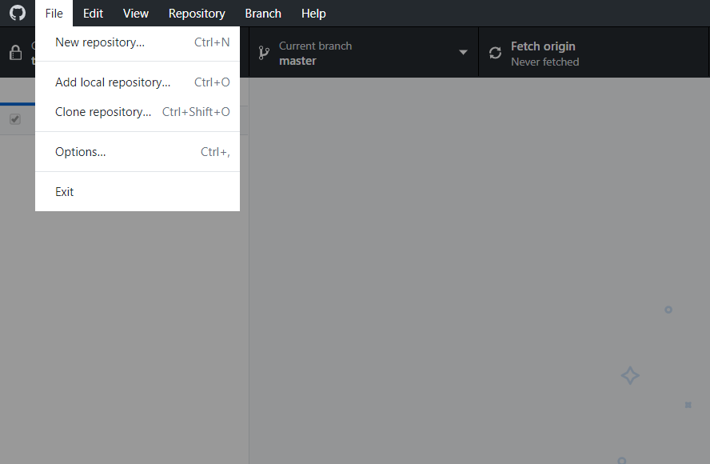
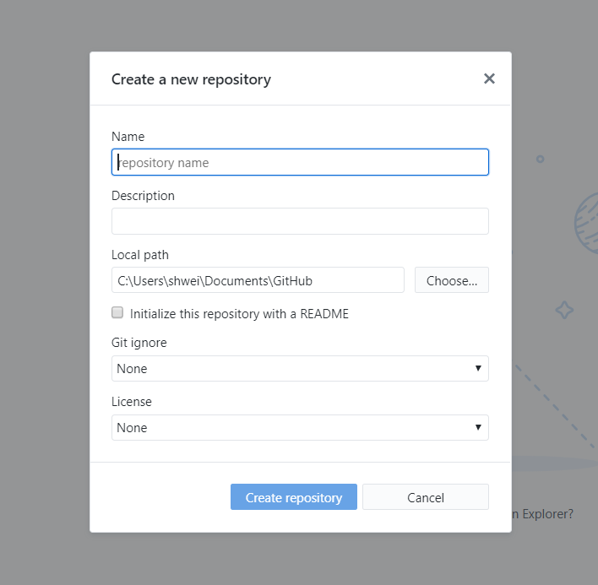
Now we can start a new project (repository) from scratch.

Slide 16
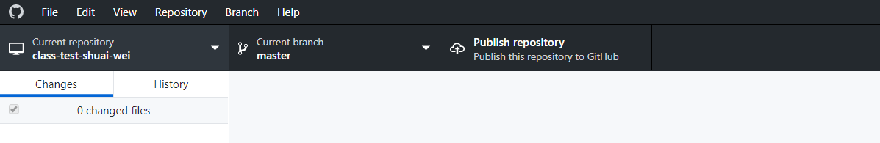
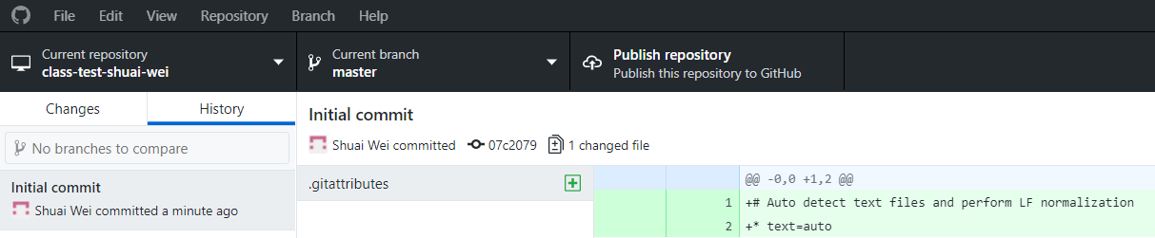
First look at the new repository by Github Desktop.

Slide 17
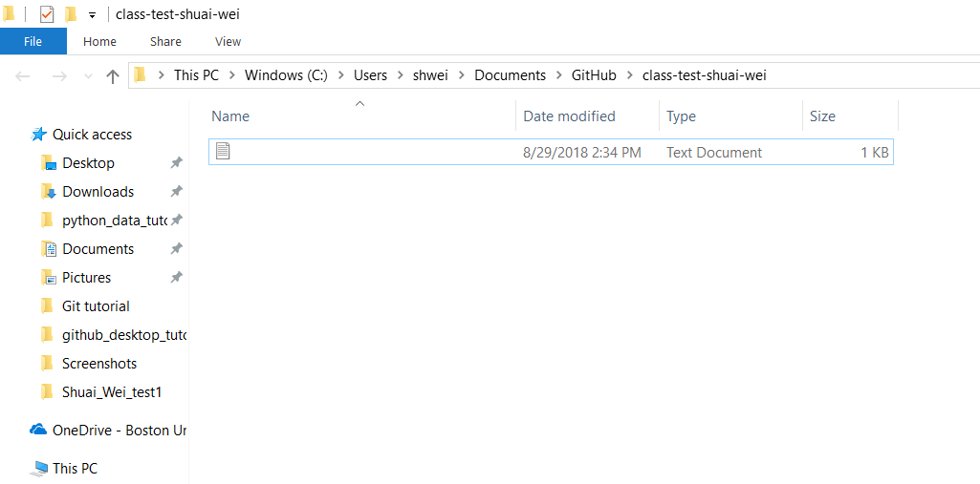
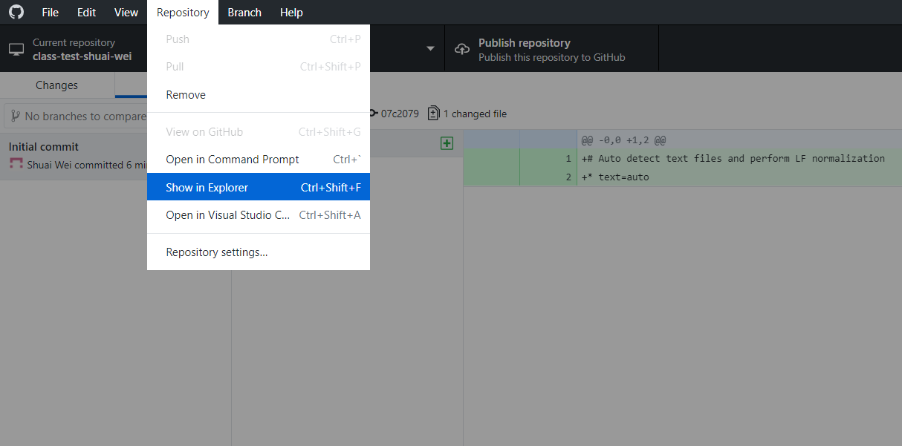
Show in folder and edit files/codes

Slide 18
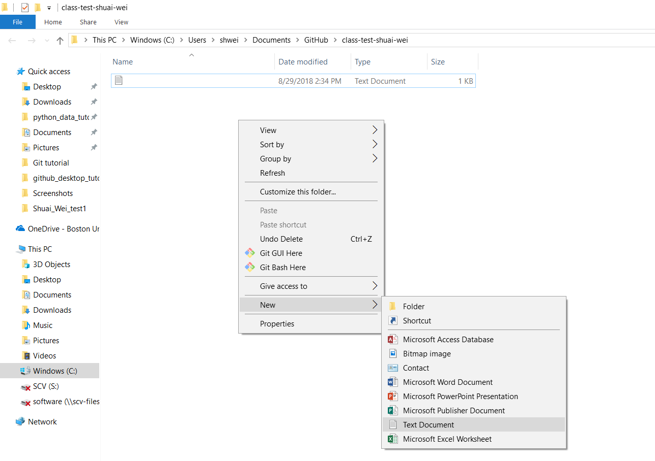
Adding a new file
Right click

Slide 19
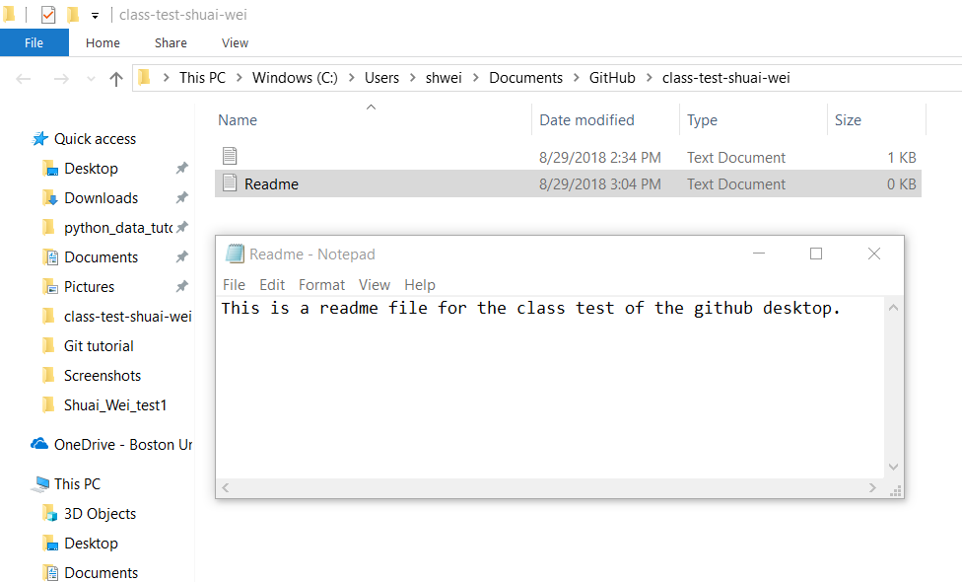
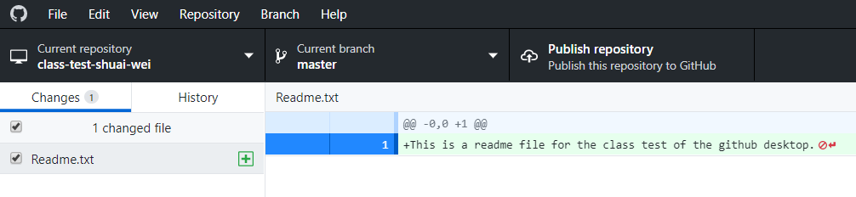
The new file can be detected by Github Desktop
Remember to save it!

Slide 20
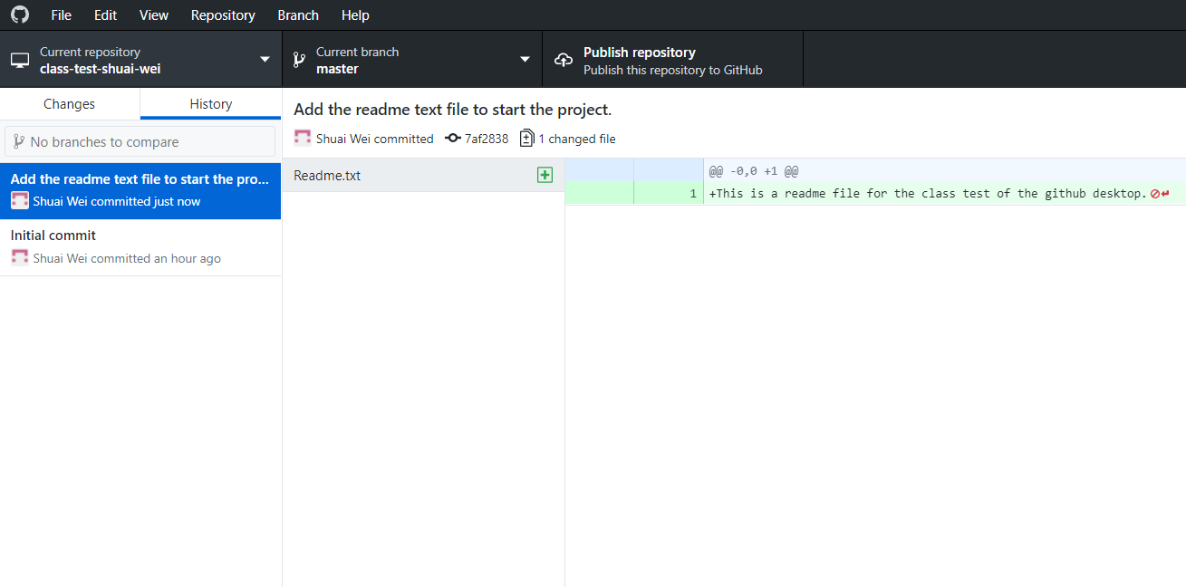
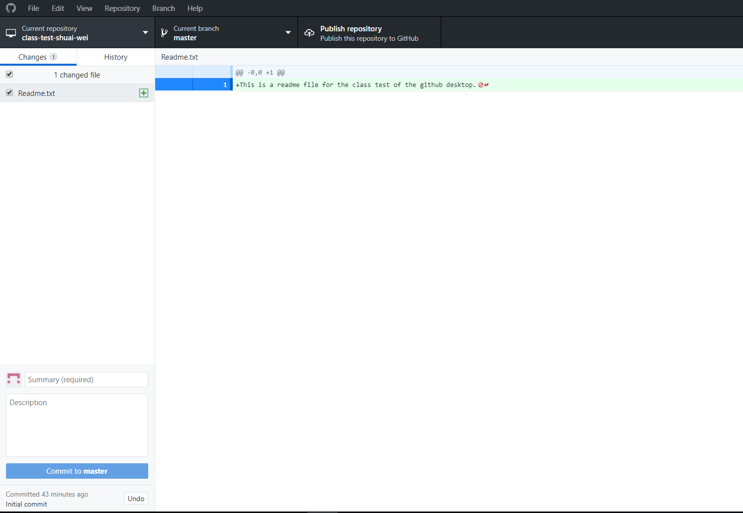
Commit this accepted change
Now click on this button to push it to Github.com repository.
This was the text input on commit title.
File name.
Input some meaningful text that briefly describe this commit.
Then click this button.

Slide 21
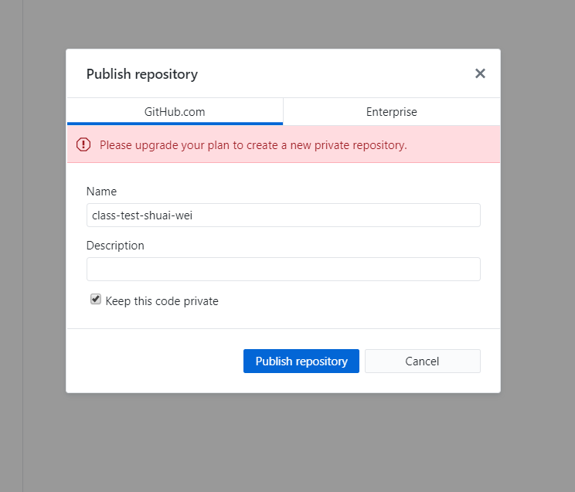
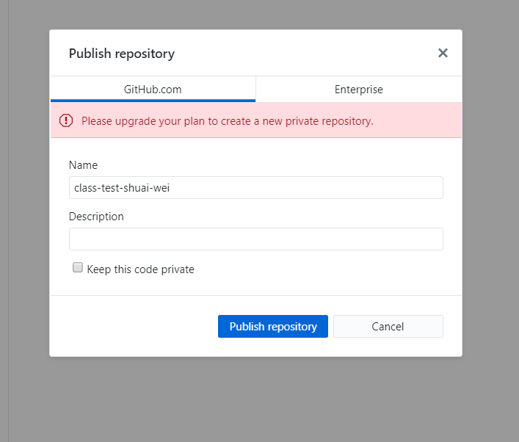
When you click on “Publish repository”
Uncheck it.

Slide 22
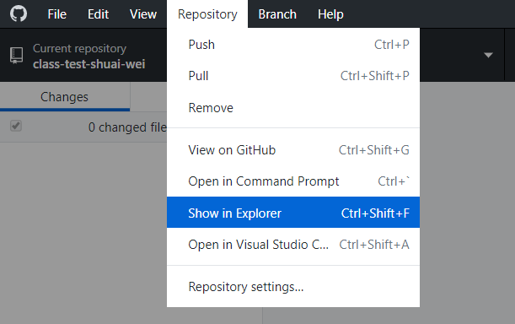
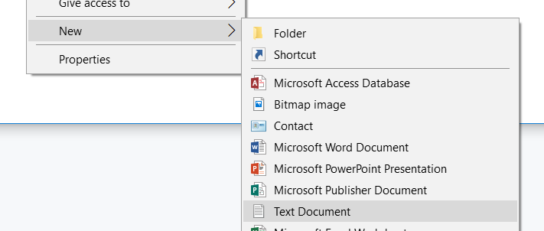
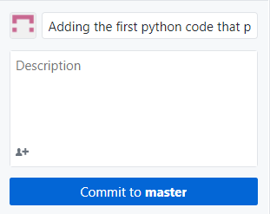
Now let’s all repeat the following steps to make the 2nd, 3rd, 4th … commits and a push.
Go to your working explorer:
Create new files:
Commit each change:
Remember to save them!

Slide 23
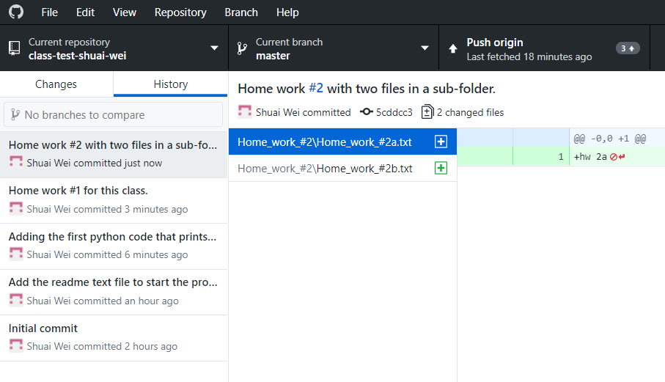
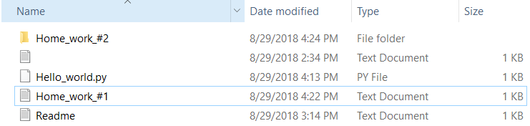
You will have a timeline of commit like this:

Slide 24
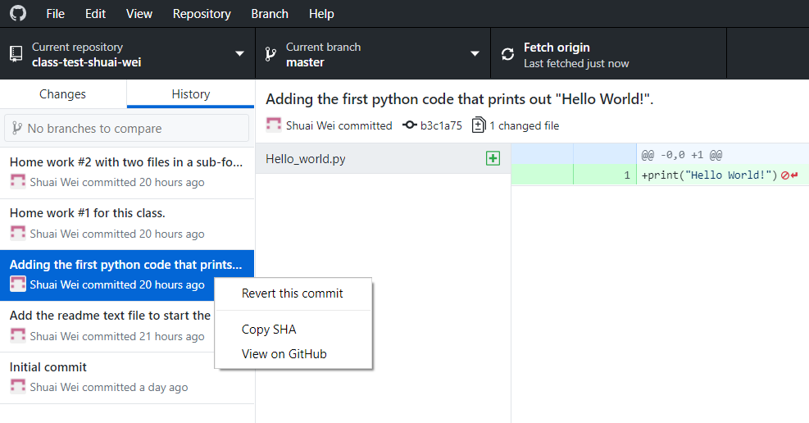
Revert a commit.
Right click on this
commit point.

Slide 25
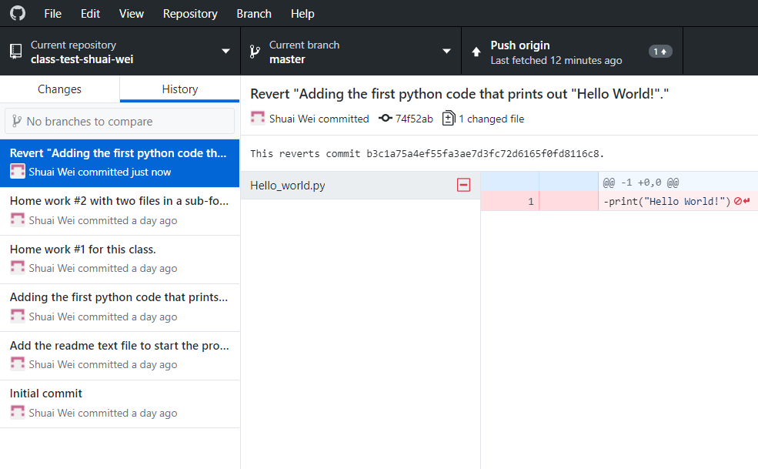
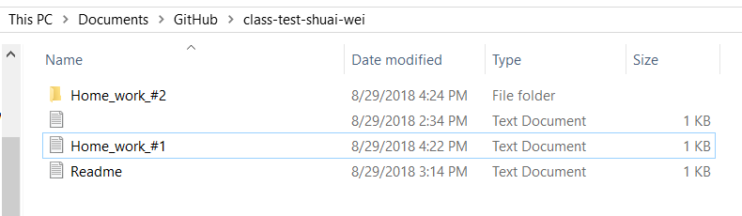
The reverted commit will be added.

Slide 26
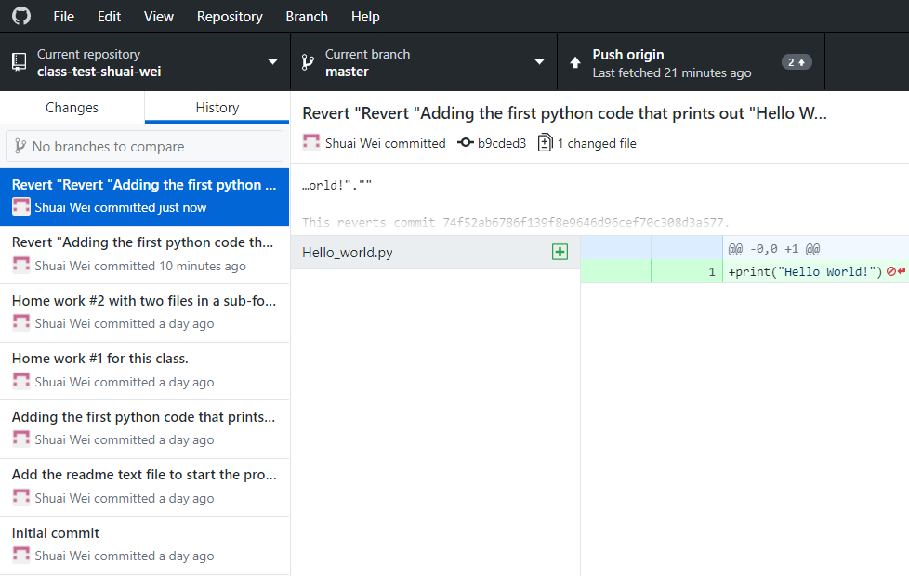
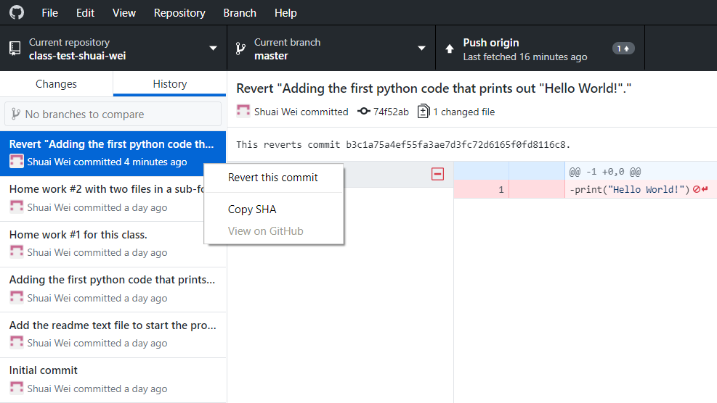
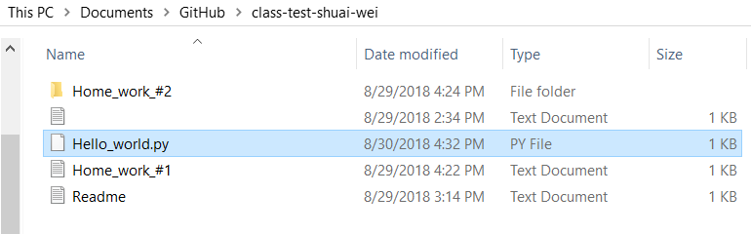
Revert the “Reverted” commit.

Slide 27
Collaborating on a project
Authorize collaborators to a private project.
Each collaborator check out/clone a copy from the github.com repository to their local computer.
Merge back to the origin repository.
Resolve conflict with collaborators.

Slide 28
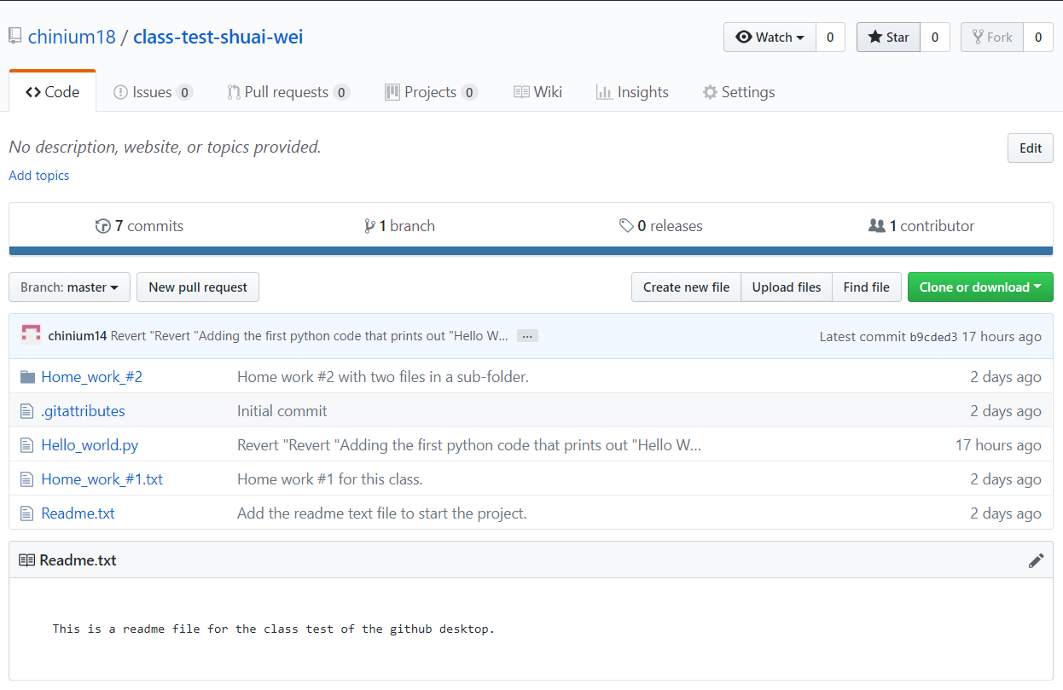
Go to your github.com repository.

Slide 29
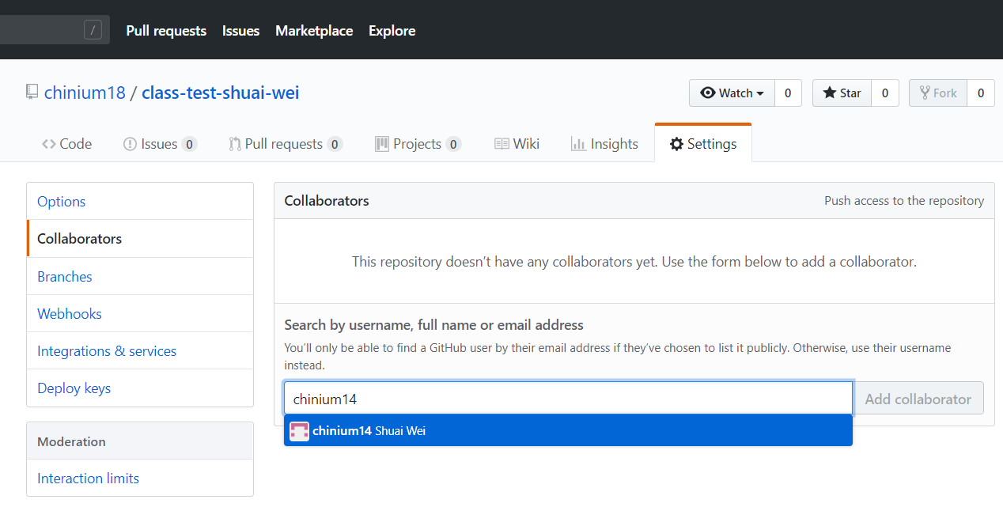
Adding collaborator to your project (repository)
Your collaborator’s github.com username

Slide 30
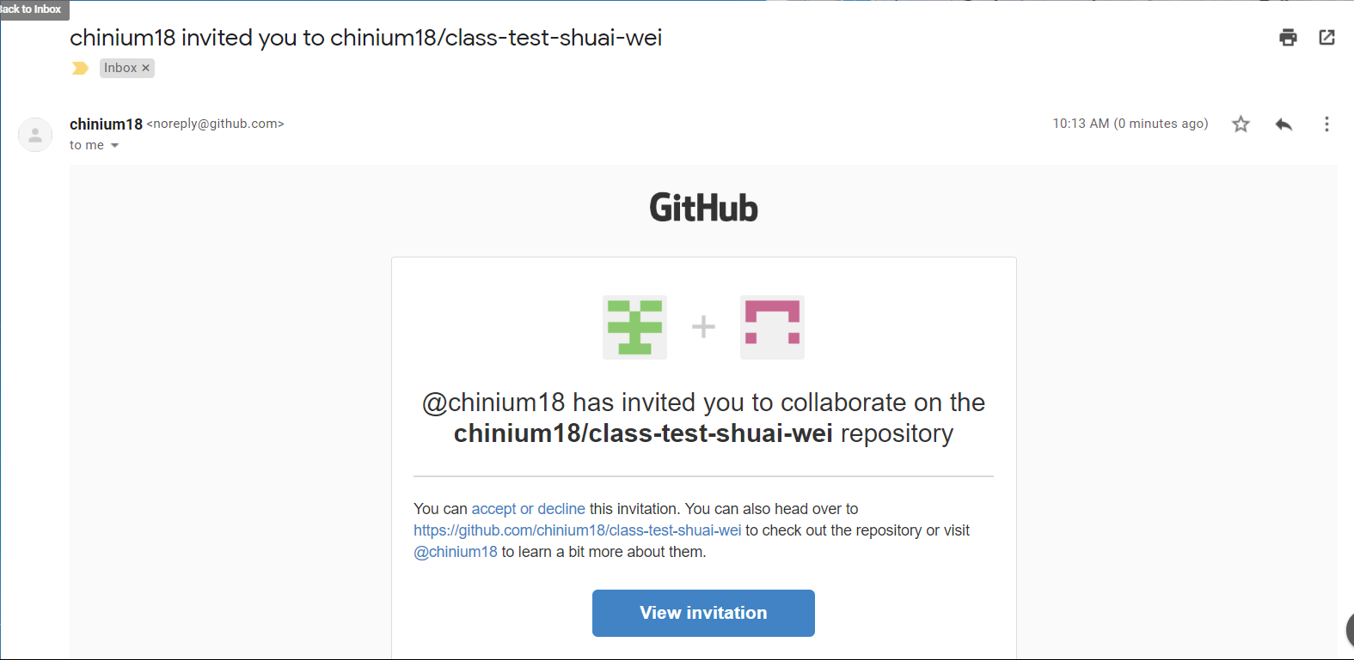
The collaborator will get an email.
Click on this link to accept it.

Slide 31
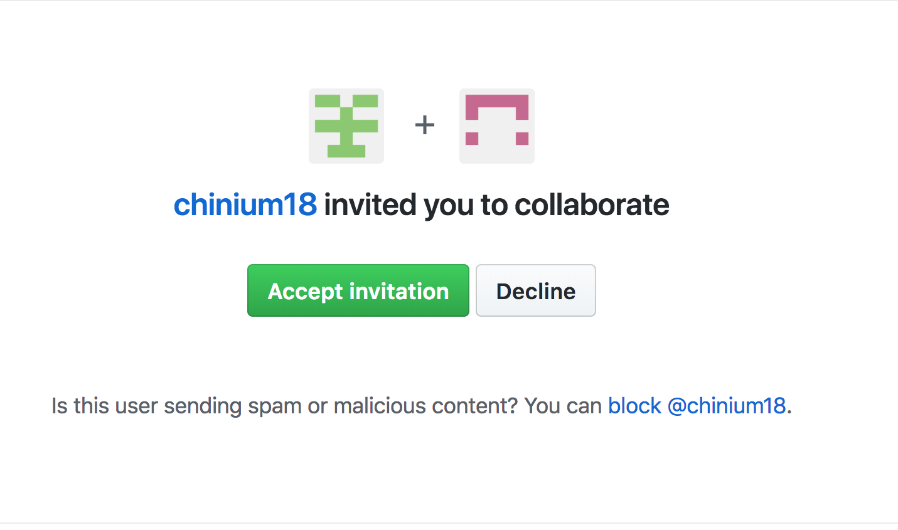
The collaborator: may check your email and find the link to this page.
Click on this button to accept the invitation.

Slide 33
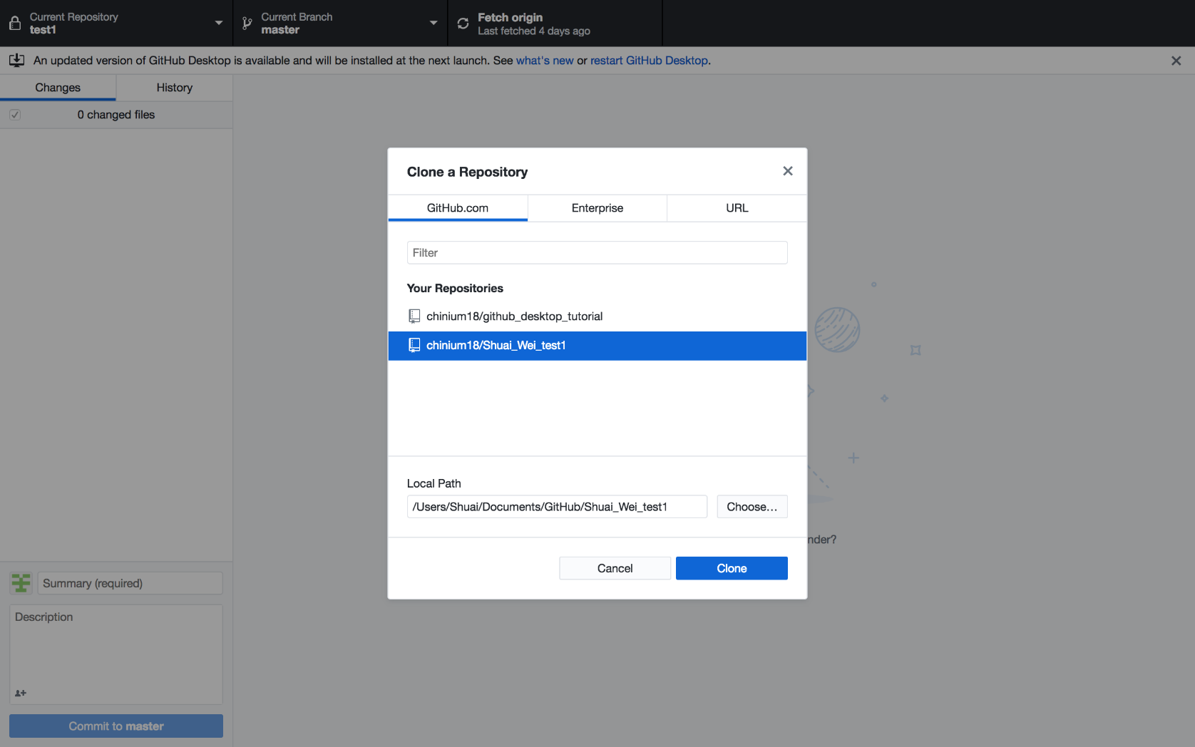
The collaborator: clone a repository from the organizer.

Slide 34
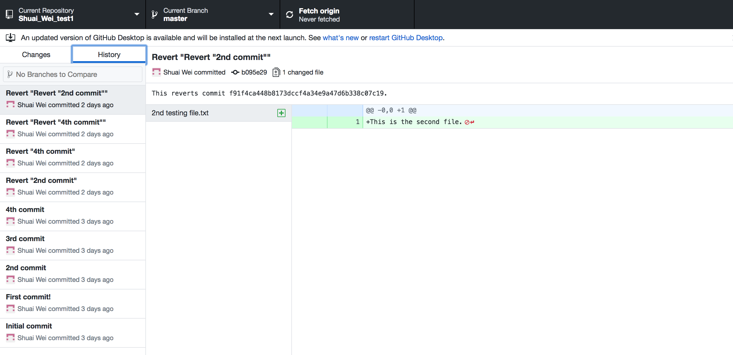
The collaborator can check out the git repository

Slide 35
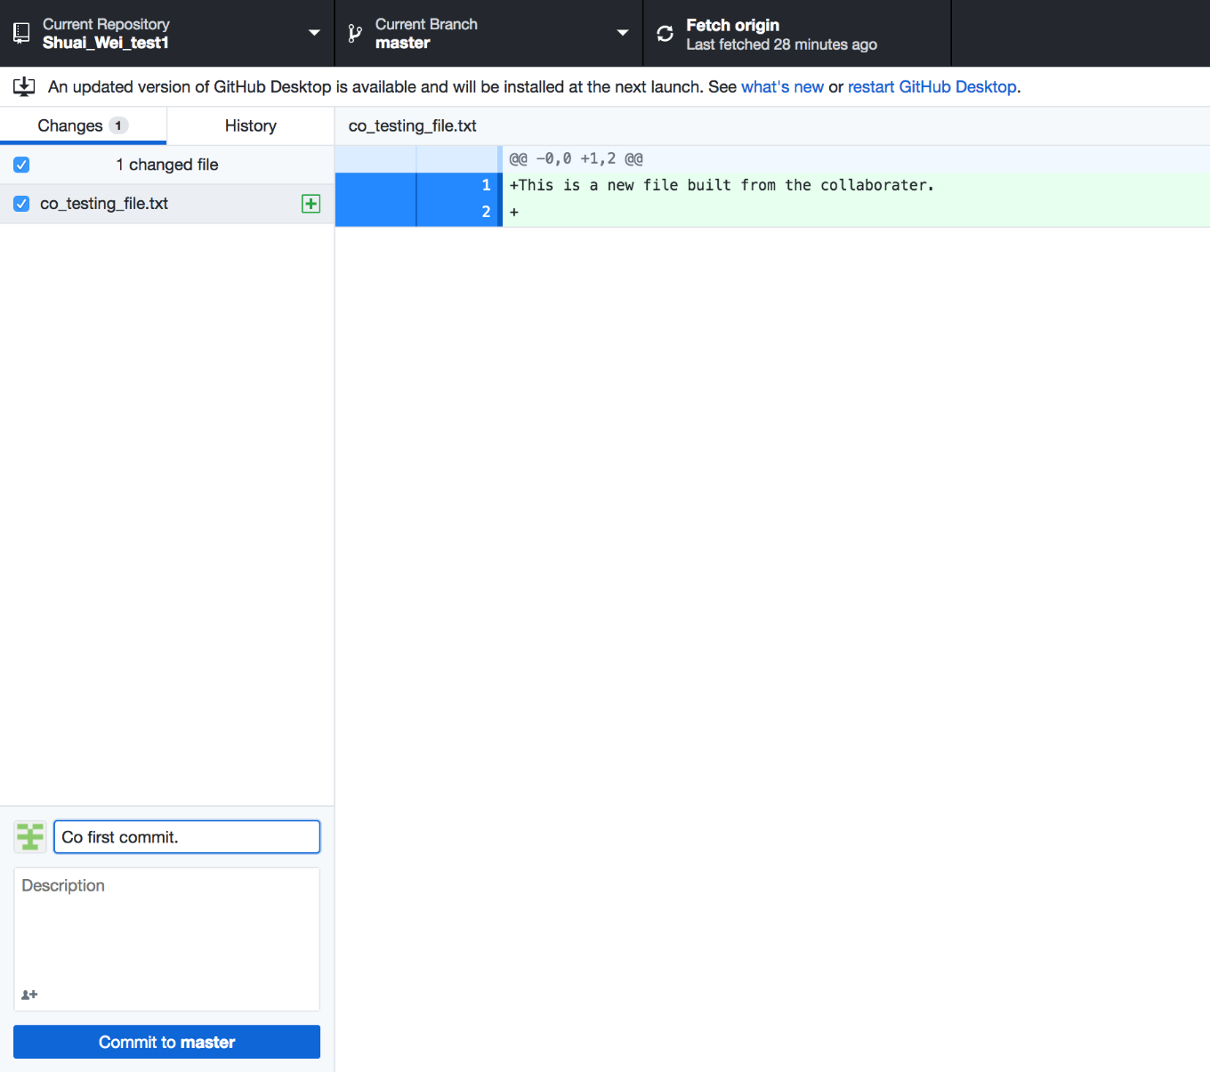
Now the collaborator can make some contribution to the repository: add a file.

Slide 36
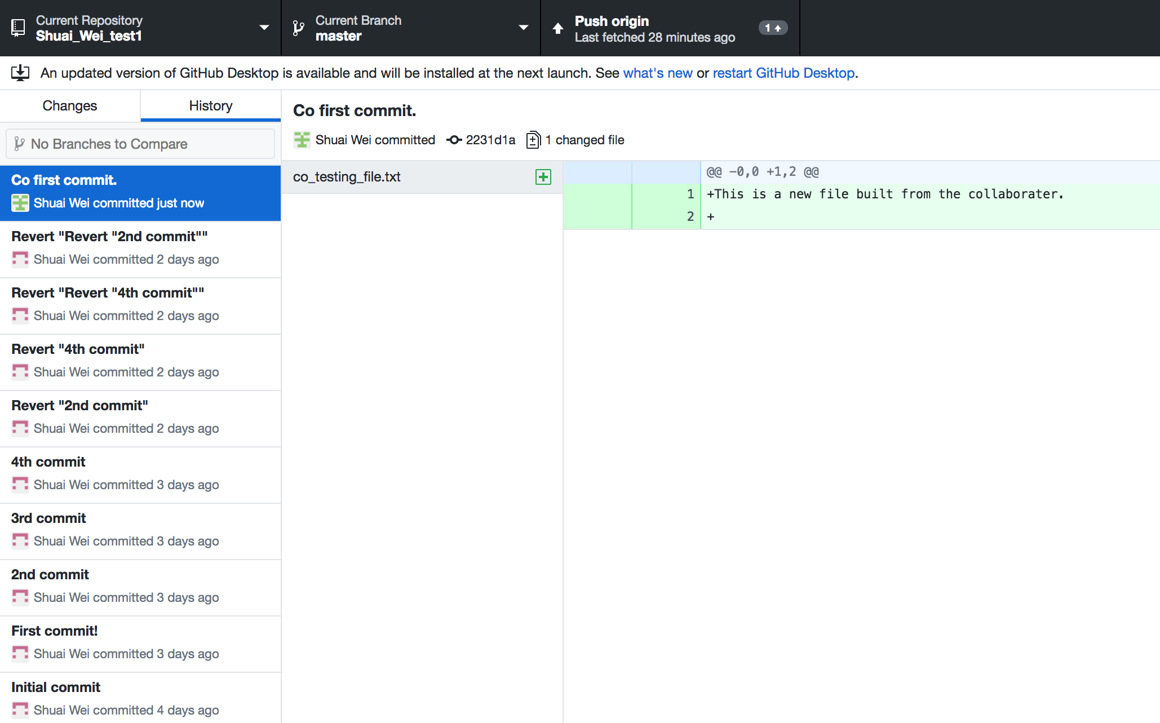
And simply push the commit to the origin repository.

Slide 37
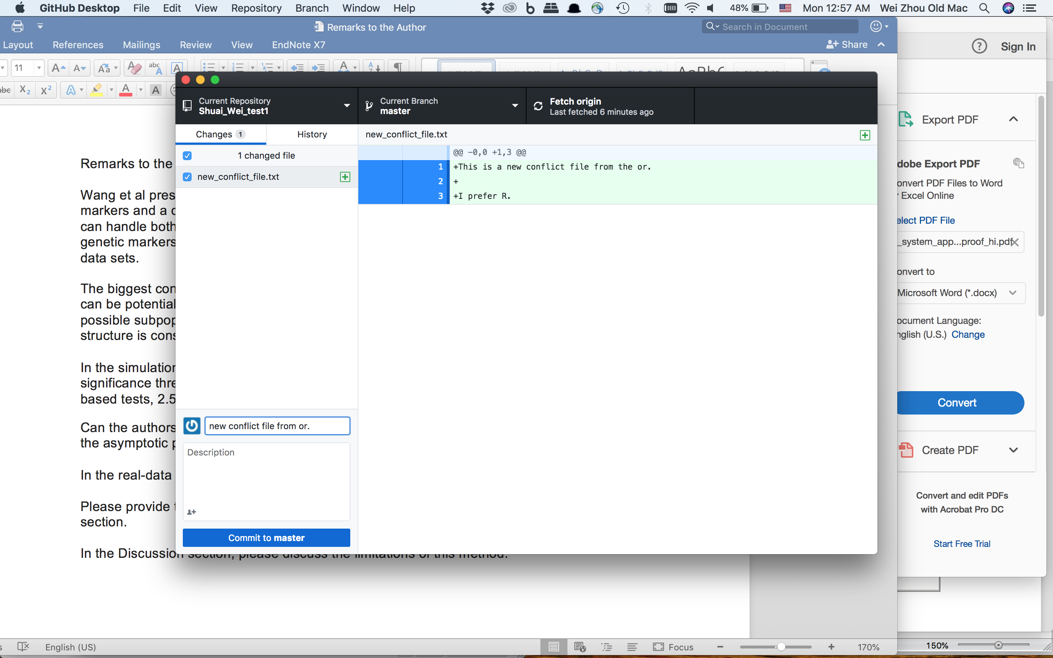
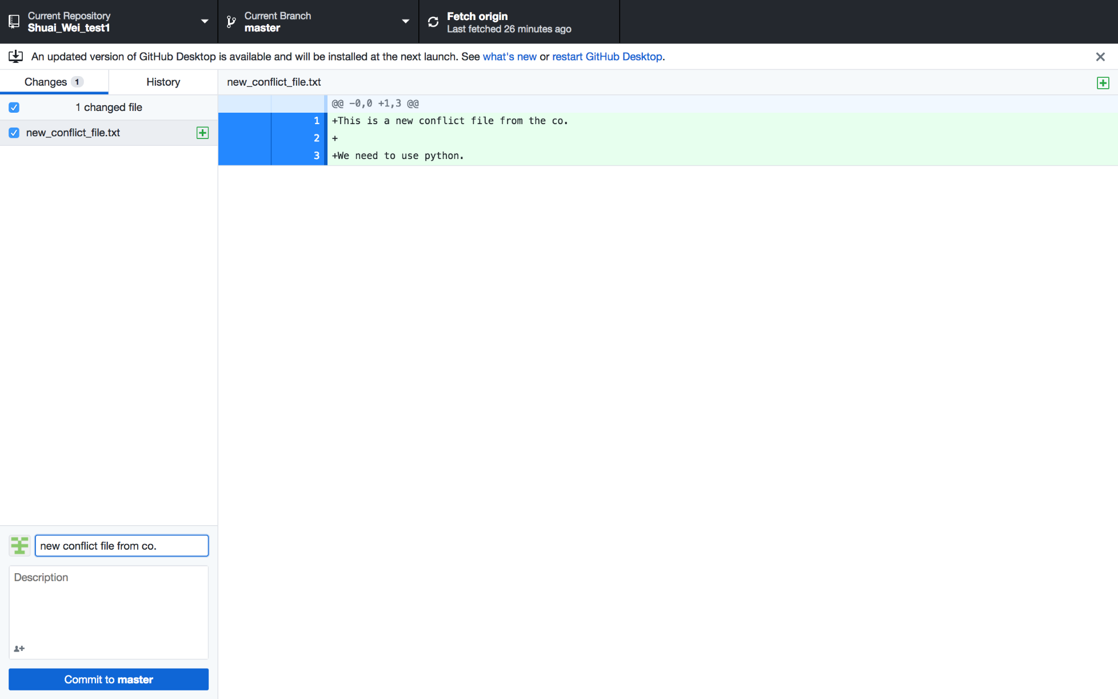
Generate a conflict between collaborators: same file name but different contents.
Conflicts here!

Slide 38
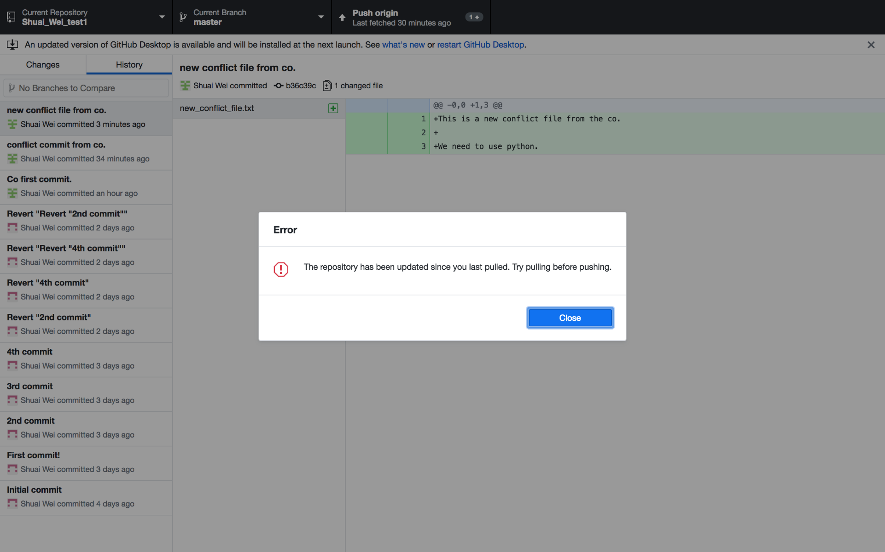
Push to the origin if you are on the latest version.

Slide 39
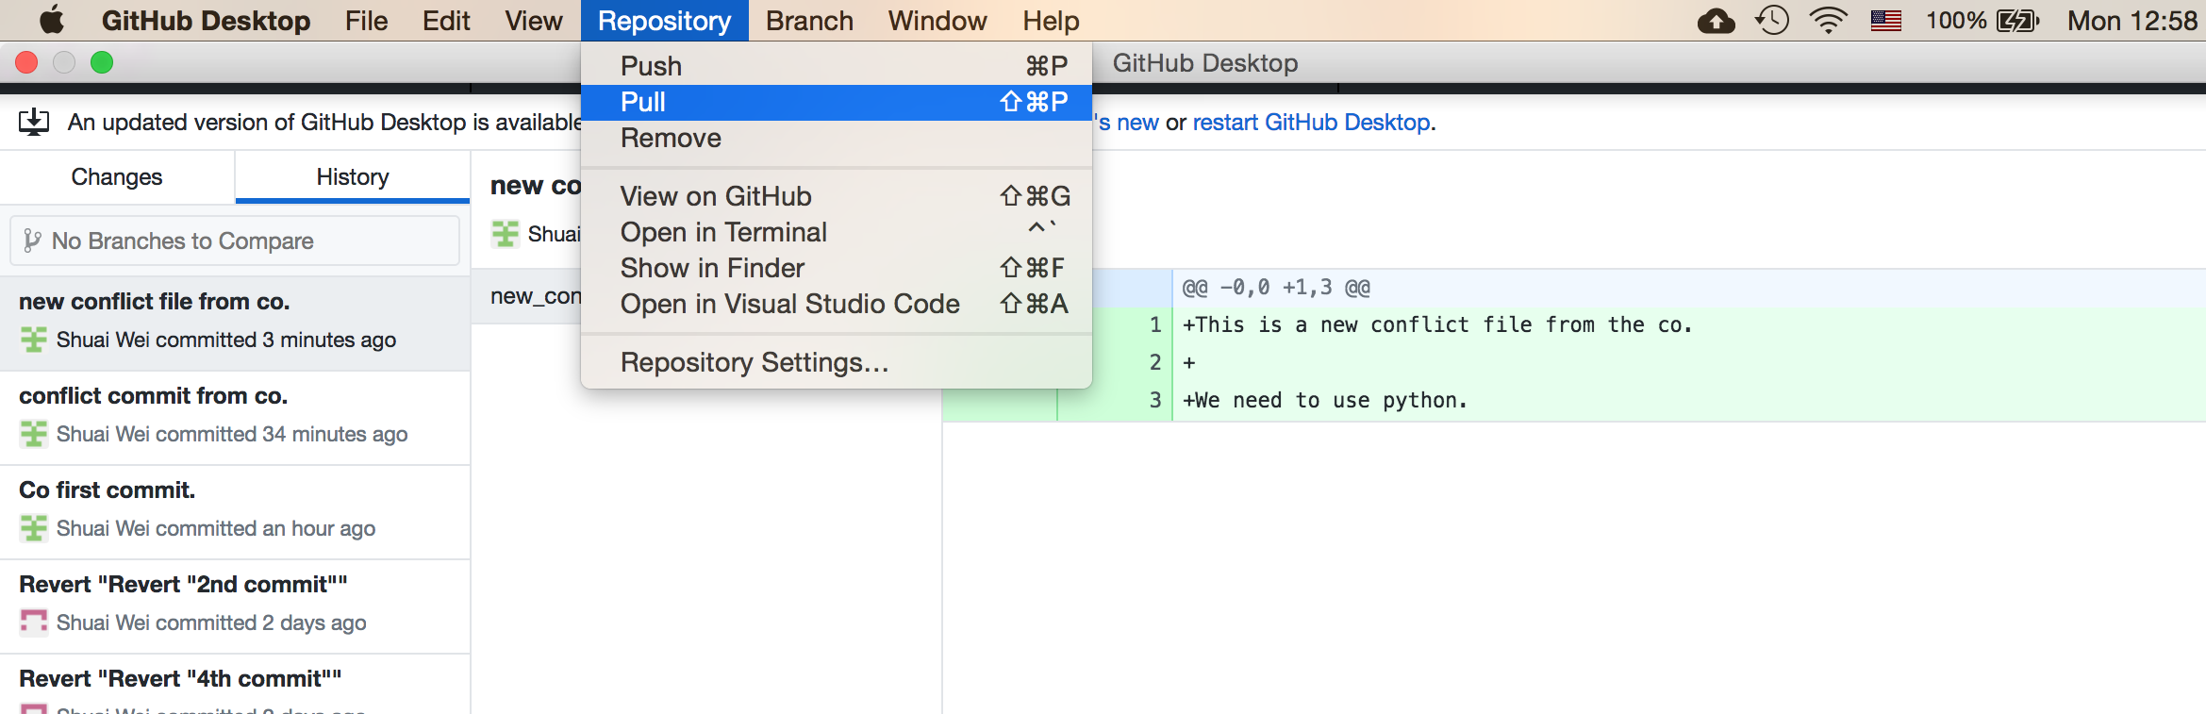
Pull the most updated version from repository

Slide 40
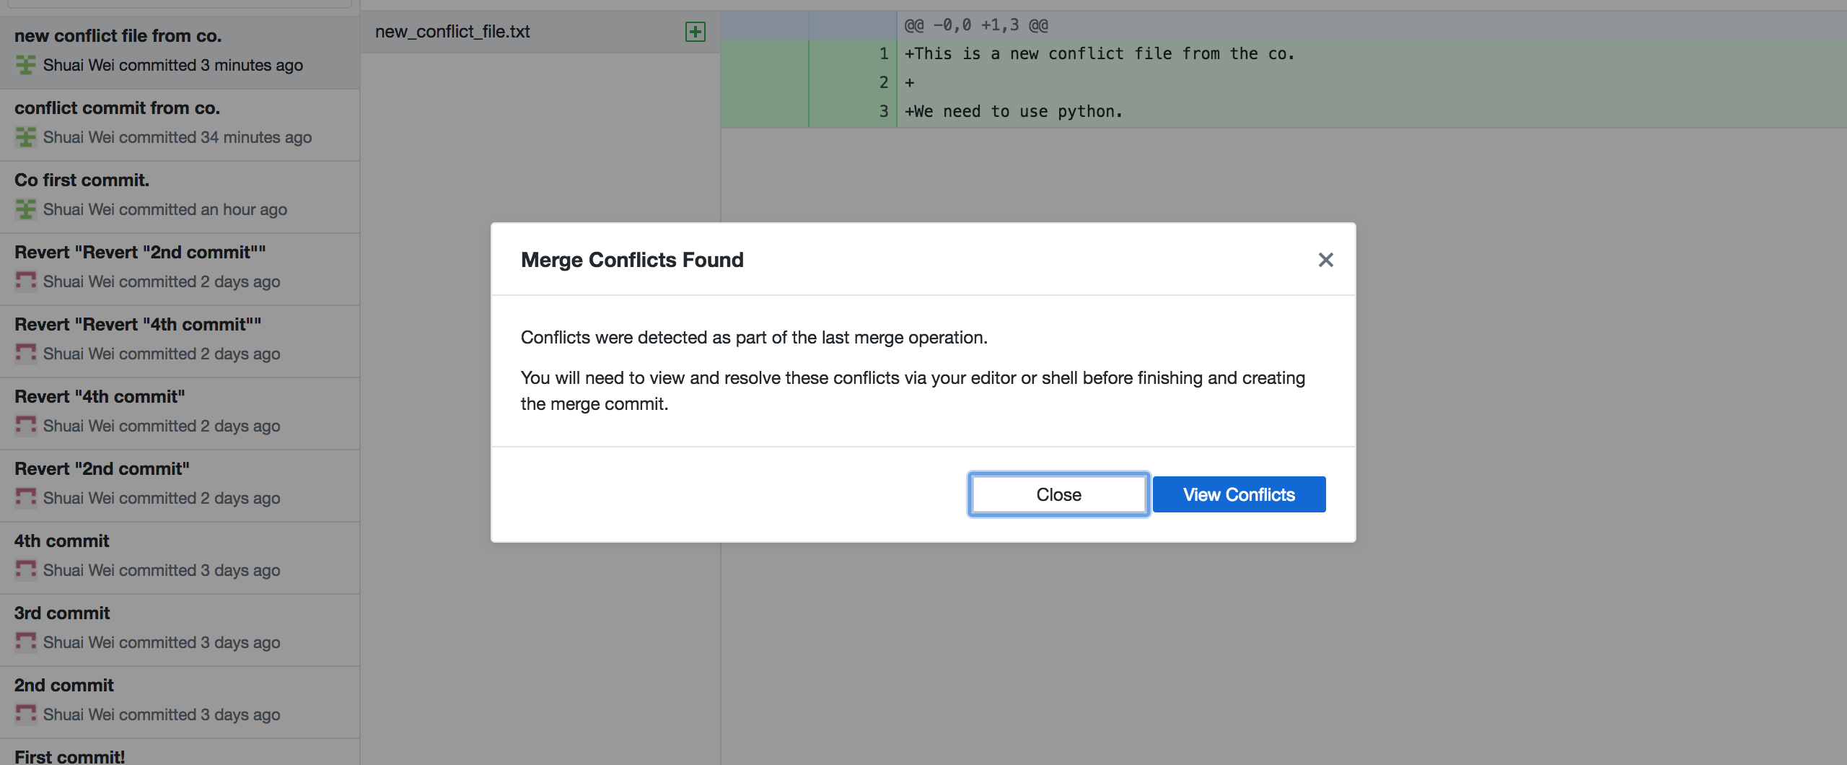
The merge conflicts found!

Slide 41
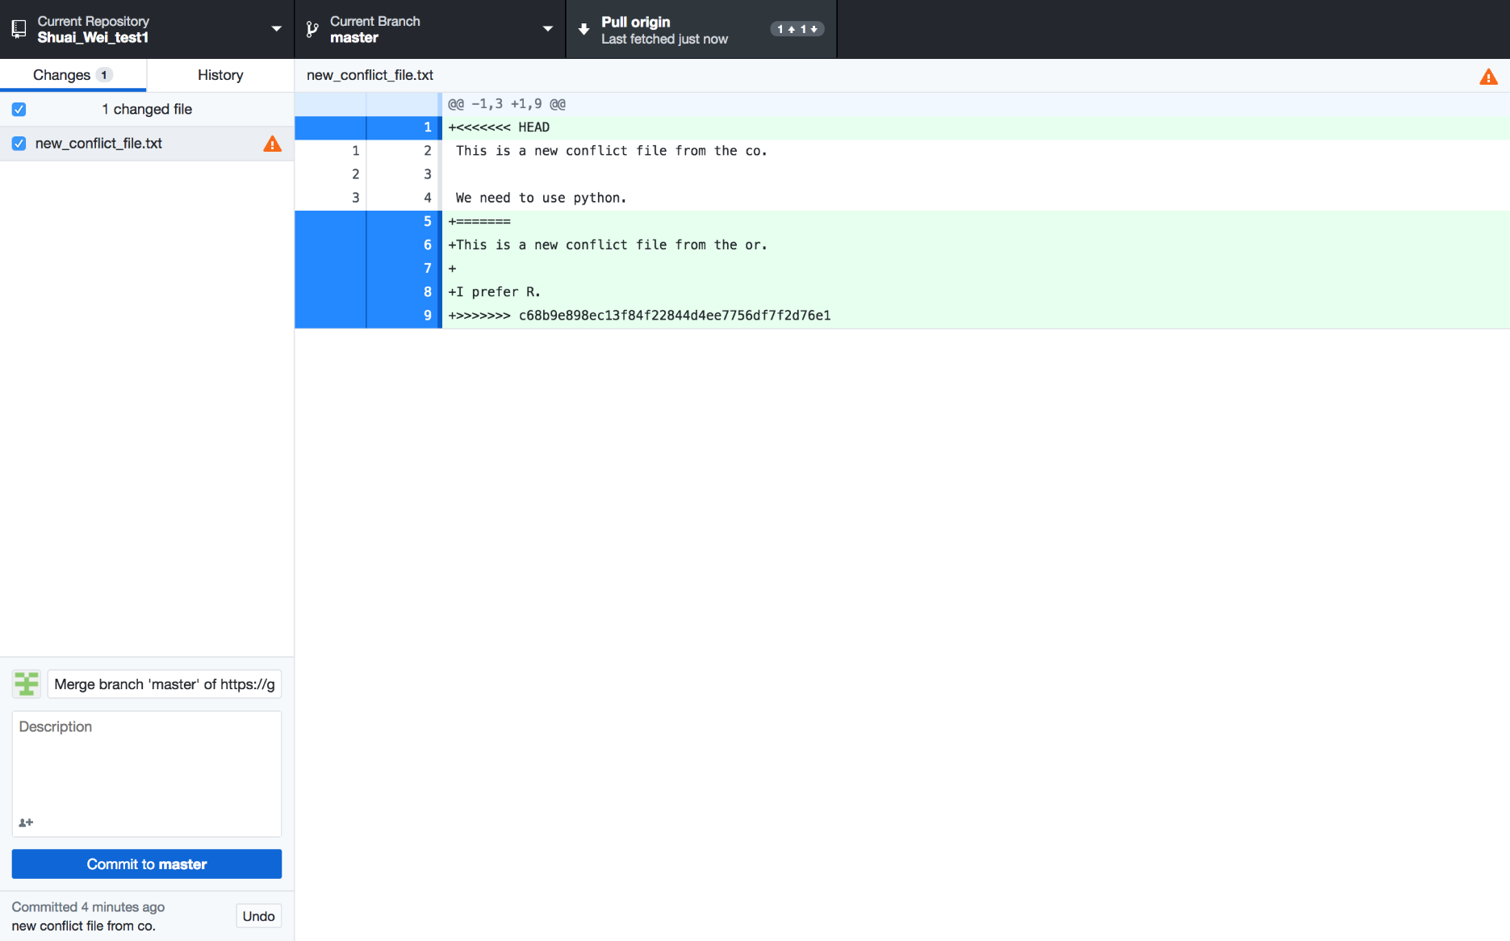
Reviewing the conflict: in the file that conflicts.

Slide 42
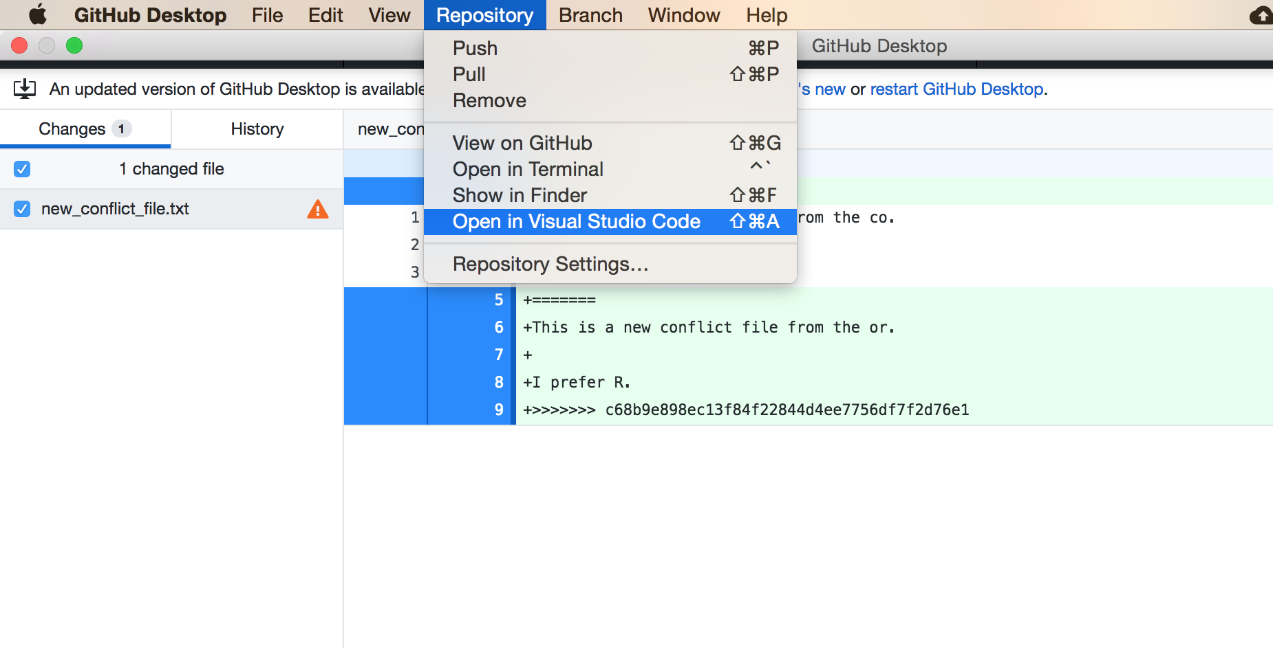
Open this file in VS Code

Slide 43

Open the file and edit it together.

Slide 44

Save the file you edited.

Slide 45

The Github Desktop view

Slide 46
Now you can commit it and push it to the origin.

Slide 47
Extras
For users who are already familiar with command lines.
Other visualization tools such as Gitk.

Slide 48

Extras: for command line users

Slide 49

Install Git to use command lines

Slide 50
Instruction for Git setup
https://help.github.com/articles/set-up-git/#setting-up-git

Slide 51

Set up Git

Slide 52

Git basic configuration
Command
Flag
Key
Value
Interpreter
program
Notes:
•Vim is the default editor used by git
•Select gedit if you are not familiar with vim or emacs editors

Slide 53

Now the command line will be available.

Slide 54

Gitk

Slide 55
Different status of files in a Git repository.

Slide 56



Branch your project

Slide 57



Make changes on the new branch

